Slide 1





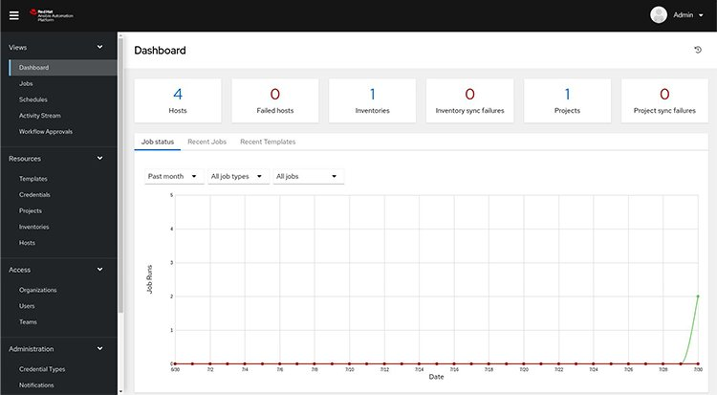








Ansible Extension for SAP Automation using SAP GUI
Ansible Developer
Non-Prod/Prod Jump-Server
SAP GUI Scripting Engine
Automate SAP application GUI through GUI Scripting engine
User
Ansible Tower Admin
Execute t-code(s) through Batch file/Ansible
In-Progress

Slide 2

S/4 HANA System Build
40 Mins
01 Mins
01 Hrs
15 Mins
15 Mins
Preparation
Hardware Validation
Run HCMT
(Only for HANA)
Approve for the OS Configuration & Installation
Pre-Requisites checks
Configuration aligning to build standards
Success
BASIS Consultant
Evidence Collection
15 Mins
15 Mins
15 Mins
150 Mins
10 Mins
10 Mins
Post-Installation Update Profile & Restart
Approve for the
Post-Installation Activities
Install Additional Application
Install
PAS
Install
DB Instance
Install
ASCS
HANA DB
Installation
Evidence Collection
02 Mins
02 Mins
02 Mins
02 Mins
05 Mins
05 Mins
Post-Installation (STMS)
Post-Installation (SMLG)
Post-Installation (Create User – Frun Integration)
Post-Installation (Configure Download Service)
…………
Post-Installation HostAgent Hardening
Post-Installation HDBUser Store
05 Mins
02 Mins
Post-Installation (Router Enteries)
Post-Installation Create Backup User

Slide 3
Automation using SAP GUI – SAP Logon Configuration & Ansible Script Execution
Manual process by PES
1
2
3
4
5
SAP GUI Settings (Refer step1)
Add SAP System Using SAP GUI
RZ 11 Configuration
(Newly added system)
Execute Ansible
(t-code script)
Validate the UI based Post Installation
1
One-time activities on client Jumserver with the collaboration of PES team using user (ansibleuser)
An alternative option is to create a new user, which the BASIS and Automation teams can use to perform the configuration
2
Add newly provisioned SAP NetWeaver System with the collaboration of PES team using user(ansibleuser)
An alternative option is to create a new user, which the BASIS and Automation teams can use to perform the configuration
3
Configure the parameter (sapgui/user_scripting = True) to enable UI scripting play
4
BASIS team will perform post installation activities using following t-codes. RZ10
STMS SM59 SCC4 SCCL SMLG SGEN SU01

Slide 4
2025 Q1 - Workflow
BASIS Automation
(Hardware Validation + HCMT)
Workflow – 1.0
BASIS consultant validation
Workflow – Day 2.0
BASIS Automation (Pre-Config + S/4 HANA Installation)
BASIS consultant validation
BASIS Automation (OS Based automation + Post Installation UI automation)
Workflow – Day 3.0

